Slide 1
Creating and Managing Variables
Statistical Analysis System

Slide 2
Basic concepts
create variables that accumulate variable values
initialize values of accumulator variables
assign values to variables conditionally
specify an alternative action when a condition is false
specify lengths for variables
delete unwanted observations
select variables
assign permanent labels and formats.

Slide 3


Introduction
This chapter shows you additional techniques for creating and managing variables. In this chapter, you learn how to create accumulator variables, assign variable values conditionally, select variables, and assign permanent labels and formats to variables.

Slide 4
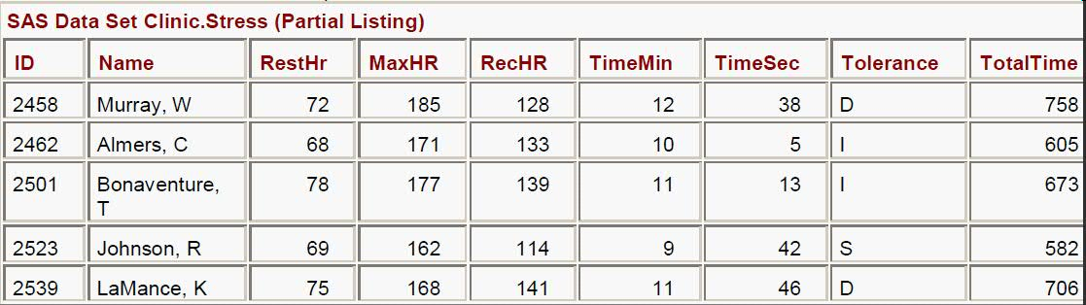
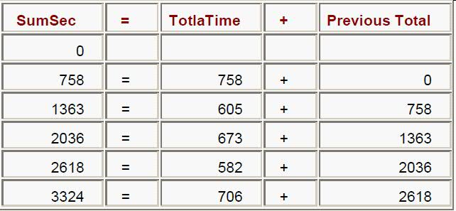
Creating and Modifying Variables
Accumulating Totals
It is often useful to create a variable that accumulates the values of another variable. Suppose you want to create the data set Clinic.Stress and to add a new variable, SumSec, to accumulate the total number of elapsed seconds in treadmill stress tests.
data clinic.stress;
infile tests;
input ID $ 1-4 Name $ 6-25
RestHR 27-29 MaxHR 31-33
RecHR 35-37 TimeMin 39-40
TimeSec 42-43
Tolerance $ 45;
TotalTime=(timemin*60)+timesec;
SumSec+totaltime;
run;

Slide 5
Initializing Accumulator Variables (page 1)
The accumulator variable SumSec was initialized to 0 by default before the first observation was read.
You can use the RETAIN statement to assign an initial value other than the default value of 0 to a variable whose value is assigned by a Sum statement.
The RETAIN statement
assigns an initial value to a retained variable
prevents variables from being initialized each time the DATA step executes.

Slide 6
Initializing Accumulator Variables (page 2)
General form, simple RETAIN statement for initializing accumulator variables:
RETAIN variable initial-value;
where
variable is a variable whose values you want to retain
initial-value specifies an initial value (numeric or character) for the preceding variable.
Note The RETAIN statement
is a compile-time only statement that creates variables if they do not already exist
initializes the retained variable to missing before the first execution of the DATA step if you do not supply an initial value
has no effect on variables that are read with SET, MERGE, or UPDATE statements. (The SET and MERGE statements are discussed in later chapters.)

Slide 7
Example for usage of RETAIN
Suppose you want to add 5400 seconds (the accumulated total seconds from a previous treadmill stress test) to the variable SumSec in the Clinic.Stress data set when you create the data set. To initialize SumSec with the value 5400, you use the RETAIN statement shown below:
data clinic.stress;
infile tests;
input ID $ 1-4 Name $ 6-25 RestHR 27-29 MaxHR 31-33
RecHR 35-37 TimeMin 39-40 TimeSec 42-43
Tolerance $ 45;
TotalTime=(timemin*60)+timesec;
retain SumSec 5400;
sumsec+totaltime;
run;

Slide 8
Assigning Values Conditionally
To perform an action conditionally, use an IF-THEN statement. The IF-THEN statement executes a SAS statement when the condition in the IF clause is true.
General form, IF-THEN statement:
IF expression THEN statement;
where
expression is any valid SAS expression
statement is any executable SAS statement.

Slide 9
Example of assignment of variables conditionally
Example
To assign the value Long to the variable TestLength when the value of TotalTime is greater than 800, add the following IF-THEN statement to your DATA step:
  data clinic.stress;
  infile tests;
  input ID $ 1-4 Name $ 6-25 RestHR 27-29 MaxHR 31-33
  RecHR 35-37 TimeMin 39-40 TimeSec 42-43
  Tolerance $ 45;
  TotalTime=(timemin*60)+timesec;
  retain SumSec 5400;
  sumsec+totaltime;
  if totaltime>800 then TestLength='Long';
  run;
NOTE: SAS executes the assignment statement only when the condition (TotalTime>800) is true. If the condition is false, then the value of TestLength will be missing.

Slide 10
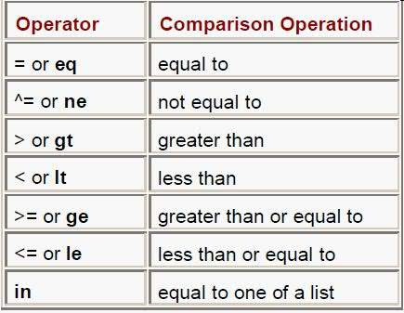
Comparison Operators
When writing IF-THEN statements, you can use any of the following comparison operators:
Example
if test<85 and time<=20
then Status='RETEST';
if region in ('NE','NW','SW')
then Rate=fee-25;
if target gt 300 or sales ge 50000
then Bonus=salary*.05;

Slide 11
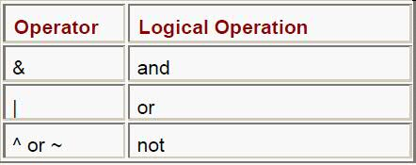
Logical Operator
You can also use these logical operators in SAS:
Example 1
if status='OK' and type=3
then Count+1;
if (age^=agecheck | time^=3)
& error=1 then Test=1;
Example 2
if (age^=agecheck | time^=3)
& error=1 then Test=1;
if status='S' or cond='E'
then Control='Stop';

Slide 12
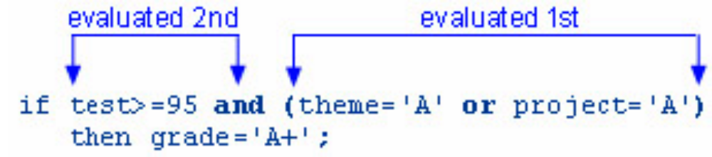
Evaluation precedence
Logical comparisons that are enclosed in parentheses are evaluated as true or false before they are compared to other expressions. In the example below, the OR comparison in parentheses is evaluated before the first expression and the AND operator are evaluated.

Slide 13
Providing an Alternative Action
Now suppose you want to assign a value to TestLength that is based on the other possible values of TotalTime. One way to do this is to add IF-THEN statements to the other two conditions, as shown below.
if totaltime>800 then TestLength='Long';
if 750<=totaltime<=800 then TestLength='Normal';
if totaltime<750 then TestLength='Short';
Instead of using a series of IF-THEN statements, you can use the ELSE statement to specify an alternative action to be performed when the condition in an IF-THEN statement is false.
if totaltime>800 then TestLength='Long';
else if 750<=totaltime<=800 then TestLength='Normal';
else if totaltime<750 then TestLength='Short';

Slide 14
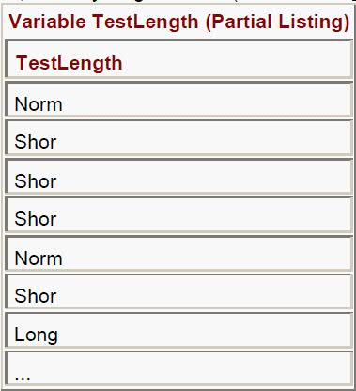
Specifying Lengths for Variables (Page 1)
Lets see with an Example
data clinic.stress;
infile tests;
input ID $ 1-4 Name $ 6-25 RestHR 27-29
MaxHR 31-33 RecHR 35-37 TimeMin 39-40
TimeSec 42-43 Tolerance $ 45;
TotalTime=(timemin*60)+timesec;
retain SumSec 5400;
sumsec+totaltime;
if totaltime>800 then TestLength='Long';
else if 750<=totaltime<=800 then TestLength='Normal';
else if totaltime<750 then TestLength='Short';
run;

Slide 15
Specifying Lengths for Variables (Page 2)
During compilation phase, when creating a new character variable in an assignment statement, SAS allocates as many bytes of storage space as there are characters in the first value that it encounters for that variable. In this case, the first value for TestLength occurs in the IF-THEN statement, which specifies a four-character value (Long). So TestLength is assigned a length of 4, and any longer values (Normal and Short) are truncated.
You can use a LENGTH statement to specify a length (the number of bytes) for TestLength before the first value is referenced elsewhere in the DATA step.
General form, LENGTH statement:
LENGTH variable(s) <$> length;
where
variable(s) names the variable(s) to be assigned a length
$ is specified if the variable is a character variable
length is an integer that specifies the length of the variable..

Slide 16
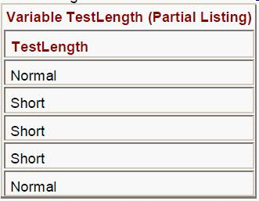
Specifying Lengths for Variables (Page 3)
data clinic.stress;
infile tests;
input ID $ 1-4 Name $ 6-25 RestHR 27-29 MaxHR 31-33
RecHR 35-37 TimeMin 39-40 TimeSec 42-43
Tolerance $ 45;
TotalTime=(timemin*60)+timesec;
retain SumSec 5400;
sumsec+totaltime;
length TestLength $ 6;
if totaltime>800 then testlength='Long';
else if 750<=totaltime<=800 then testlength='Normal';
else if totaltime<750 then TestLength='Short';
run;
Note Make sure the LENGTH statement appears before any other reference to the
variable in the DATA step. If the variable has been created by another
statement, then a later use of the LENGTH statement will not change its size.

Slide 17
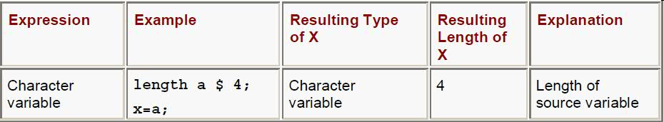
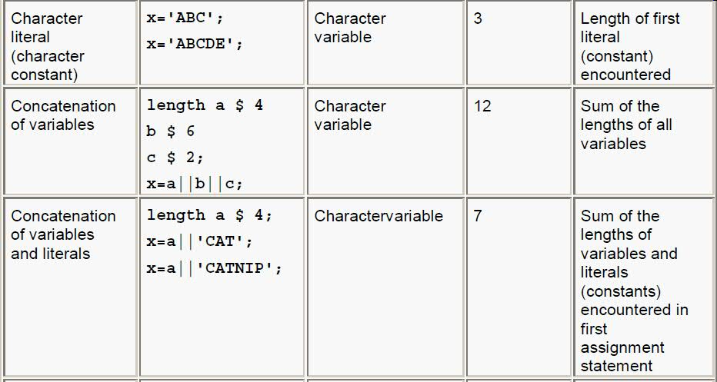
Specifying Lengths for Variables (Page 4)

Slide 18

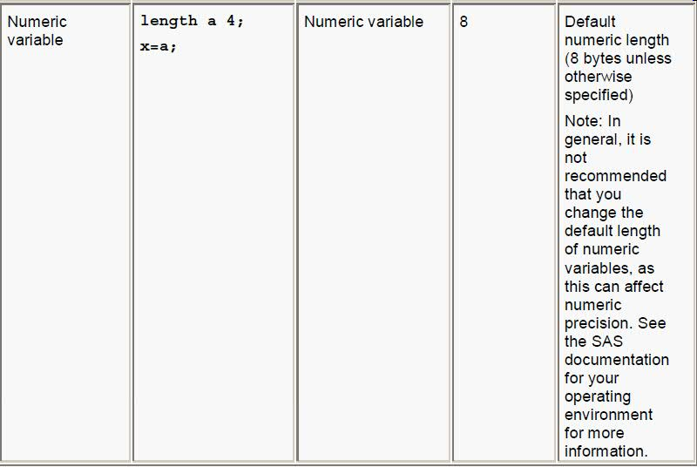
Specifying Lengths for Variables (Page 5)

Slide 19
Subsetting Data (Deleting unwanted Observations)
You can use an IF-THEN statement with a DELETE statement to determine which observations to omit from the data set that SAS is creating as it reads raw data.
The IF-THEN statement executes a SAS statement when the condition in the IF clause is true.
The DELETE statement stops processing the current observation.
General form, DELETE statement:
DELETE;
To conditionally execute a DELETE statement, you submit a statement in the following general
form:
IF expression THEN DELETE;
If the expression is
true, the DELETE statement executes, and control returns to the top of the DATA step (the observation is deleted).
false, the DELETE statement does not execute, and processing continues with the next statement in the DATA step.

Slide 20
Example for deleting unwanted Observations
data clinic.stress;
  infile tests;
  input ID $ 1-4 Name $ 6-25 RestHR 27-29 MaxHR 31-33
  RecHR 35-37 TimeMin 39-40 TimeSec 42-43
  Tolerance $ 45;
  if resthr<70 then delete;
  TotalTime=(timemin*60)+timesec;
  retain SumSec 5400;
  sumsec+totaltime;
  length TestLength $ 6;
  if totaltime>800 then testlength='Long';
  else if 750<=totaltime<=800 then testlength='Normal';
  else if totaltime<750 then TestLength='Short';
run;

Slide 21
Selecting Variables with the DROP= and KEEP= Data Set Options
Sometimes you might need to read and process fields that you don’t want to keep in your data set. In this case, you can use the DROP= and KEEP= data set options to specify the variables that you want to drop or keep.
  General form, DROP= and KEEP= data set options:
  (DROP=variable(s))
  (KEEP=variable(s))
  where
  the DROP= or KEEP= option, in parentheses, follows the name of the data set that contains the variables to be dropped or kept
  variable(s) identifies the variables to drop or keep.
  Example
  data clinic.stress(drop=timemin timesec);
  infile tests;
  .
  .
  Run;

Slide 22
Selecting Variables with the DROP= and KEEP= statements
General form, DROP and KEEP statements:
DROP variable(s);
KEEP variable(s);
where variable(s) identifies the variables to drop or keep.
Example
data clinic.stress;
infile tests;
.
drop timemin timesec;
.
.
run;

Slide 23
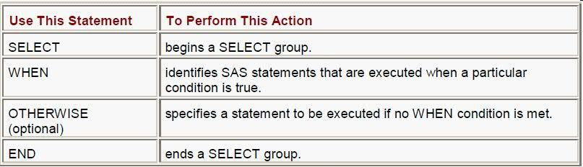
Assigning Values Conditionally Using SELECT Groups
To assign values conditionally by using IF-THEN/ELSE statements. You can also use SELECT groups in DATA steps to perform conditional processing. A SELECT group contains these statements:

Slide 24
General form, SELECT group:
SELECT <(select-expression)>;
WHEN-1 (when-expression-1 <..., when-expression-n>) statement;
WHEN-n (when-expression-1 <..., when-expression-n>) statement;
<OTHERWISE statement;>
END;
where
SELECT begins a SELECT group.
the optional select-expression specifies any SAS expression that evaluates to a single value.
WHEN identifies SAS statements that are executed when a particular condition is true.
when-expression specifies any SAS expression, including a compound expression. You must specify at least one when-expression.
statement is any executable SAS statement. You must specify the statement argument.
the optional OTHERWISE statement specifies a statement to be executed if no WHEN condition is met.
END ends a SELECT group.

Slide 25
Example code for Select Groups
select(jobcode);
  when ("FA1") group="Flight Attendant I";
  when ("FA2") group="Flight Attendant II";
  when ("FA3") group="Flight Attendant III";
  when ("ME1") group="Mechanic I";
  when ("ME2") group="Mechanic II";
  when ("ME3") group="Mechanic III";
  when ("NA1") group="Navigator I";
  when ("NA2") group="Navigator II";
  when ("NA3") group="Navigator III";
  when ("PT1") group="Pilot I";
  when ("PT2") group="Pilot II";
  when ("PT3") group="Pilot III";
  when ("TA1","TA2","TA3") group="Ticket Agents";
  otherwise group="Other";
end;

Slide 26
Grouping Statements Using DO Groups
Conditional processing (IF-THEN/ELSE statements and SELECT groups) that execute only a single SAS statement when a condition is true. However, you can also execute a group of statements as a unit by using DO groups.
General form, simple DO group:
DO;
SAS statements
END;
where
the DO statement begins DO-group processing
SAS statements between the DO and END statements are called a DO group and execute as a unit
the END statement terminates DO-group processing.
Note You can nest DO statements within DO groups.

Slide 27
Example of DO GROUPS
data clinic.stress;
infile tests;
input ID $ 1-4 Name $ 6-25 RestHR 27-29 MaxHR 31-33
RecHR 35-37 TimeMin 39-40 TimeSec 42-43
Tolerance $ 45;
.
.
.
if totaltime>800 then
do;
testlength='Long';
message='Run blood panel';
end;
else if 750<=totaltime<=800 then testlength='Normal';
else if totaltime<750 then TestLength='Short';
run;

Slide 28

SAS Presentation | IBM Confidential | Nov 7, 2026

